Slide 1
Information Search
Ying shen
Sse, tongji university
Jan. 2018

Slide 2
Outline
Introduction
Five-stage search framework
Dynamic queries and faceted search
Command languages and “natural” language queries
Multimedia Document Search & specialized search
The Social aspects of search

Slide 3
Outline
Introduction
Five-stage search framework
Dynamic queries and faceted search
Command languages and “natural” language queries
Multimedia Document Search & specialized search
The Social aspects of search

Slide 4
Introduction
The indexing and retrieval of textual documents.
Searching for pages on the World Wide Web is the “killer app.”
Concerned firstly with retrieving relevant documents to a query.
Concerned secondly with retrieving from large sets of documents efficiently.
Notes:
In marketing terminology, a killer application (commonly shortened to killer app) is any computer program that is so necessary or desirable that it proves the core value of some larger technology, such as computer hardware, a gaming console, software, a programming language, a software platform, or an operating system.^{[1]} In other words, consumers would buy the (usually expensive) hardware just to run that application. A killer app can substantially increase sales of the platform on which it runs.

Slide 5
Typical IR tasks
Given:
A corpus of textual natural-language documents.
A user query in the form of a textual string.
Find:
A ranked set of documents that are relevant to the query.
Some examples of tasks
Specific fact finding (known-item search)
What are the hotels near Tongji University?
Extended fact finding
What are differences between the butterfly and the moth?
Exploration of availability
Are there new restaurants open near Tongji University this month?
Open-ended browsing and problem analysis
Are there promising new treatments for Parkinson disease?

Slide 6
IR system
Document
corpus
IR
System
Query String
1. Doc1
2. Doc2
3. Doc3
.
.
Ranked
Documents

Slide 7
Relevance
Relevance is a subjective judgment and may include:
Being on the proper subject.
Being timely (recent information).
Being authoritative (from a trusted source).
Satisfying the goals of the user and his/her intended use of the information (information need).

Slide 8
Keyword search
Simplest notion of relevance is that the query string appears verbatim in the document.
Slightly less strict notion is that the words in the query appear frequently in the document, in any order (bag of words).

Slide 9
Problems with keywords
May not retrieve relevant documents that include synonymous terms.
“restaurant” vs. “café”
“PRC” vs. “China”
May retrieve irrelevant documents that include ambiguous terms.
“bat” (baseball vs. mammal)
“Apple” (company vs. fruit)
“bit” (unit of data vs. act of eating)

Slide 10
Intelligent IR
Taking into account the meaning of the words used.
Taking into account the order of words in the query.
Adapting to the user based on direct or indirect feedback.
Taking into account the authority of the source.

Slide 11
Web search
Application of IR to HTML documents on the World Wide Web.
Differences:
Must assemble document corpus by spidering the web.
Can exploit the structural layout information in HTML (XML).
Documents change uncontrollably.
Can exploit the link structure of the web.

Slide 12
Web search system
Web
Spider
Document
corpus
IR
System
Query String
1. Page1
2. Page2
3. Page3
.
.
Ranked
Documents

Slide 13
Other IR-related tasks
Automated document categorization
Information filtering (spam filtering)
Information routing
Automated document clustering
Recommending information or products
Information extraction
Information integration
Question answering

Slide 14
History of IR
1960-70’s:
Initial exploration of text retrieval systems for “small” corpora of scientific abstracts, and law and business documents.
Development of the basic Boolean and vector-space models of retrieval.
Prof. Salton and his students at Cornell University are the leading researchers in the area.

Slide 15
History of IR
1980’s:
Large document database systems, many run by companies:
Lexis-Nexis
Dialog
MEDLINE
1990’s:
Searching FTPable documents on the Internet
Archie
WAIS
Searching the World Wide Web
Lycos
Yahoo
Altavista

Slide 16
History of IR
1990’s continued:
Organized Competitions
NIST TREC
Recommender Systems
Ringo
Amazon
NetPerceptions
Automated Text Categorization & Clustering

Slide 17
History of IR
2000’s
Link analysis for Web Search
Google
Automated Information Extraction
Parallel Processing
Map/Reduce
Question Answering
TREC Q/A track
Multimedia IR
Image
Video
Audio and music
Cross-Language IR
DARPA Tides
Document Summarization
Learning to Rank

Slide 18
Recent IR history
2010’s
Intelligent Personal Assistants
Siri
Cortana
Google Now
Alexa
Complex Question Answering
IBM Watson
Distributional Semantics
Deep Learning

Slide 19
Outline
Introduction
Five-stage search framework
Dynamic queries and faceted search
Command languages and “natural” language queries
Multimedia Document Search & specialized search
The Social aspects of search

Slide 20
Five-stage search framework
A five-stage search framework help to coordinate design practices and satisfy the needs of all users
Formulation
Initiation of action
Review of results
Refinement
Use
Five-stages can be repeated until users’ needs are met
If users’ are unsatisfied with the results, they should be able to have additional options and change their queries easily
Notes:
Formulation: Expressing the search
Initiation of action: Launching the search
Review of results: Reading messages and outcome
Refinement: Formulating the next step
Use: Compiling or disseminating insight

Slide 21
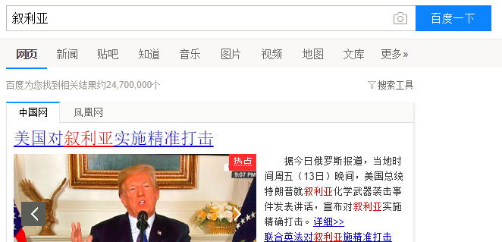
Formulation
This stage includes identifying the source of the information
The limitation of the source can lead to better results or failures
Users prefer to search a specific library
Using keywords, phrases and structured fields to limit the search scope
Text boxes, menus, and form fill-in
Users or service providers should have stop lists
Notes:
http://www.lib.tongji.edu.cn/site/tongji/cc7cff7c-bbf8-4f04-a006-281d35ebb076/index.html
http://apps.webofknowledge.com/UA_GeneralSearch_input.do?product=UA&search_mode=GeneralSearch&SID=6CBqnGjVb3edu7Dg81o&preferencesSaved=
Use simple and advance search
Limit the search using structured fields such as year, media, or location
Recognize phrases to allow entry of names, such as “George Washington”
Permit variants to allow relaxation of search constraints (e.g. phonetic variations)
Control the size of the initial result set
Use scoping of source carefully
Provide suggestions, hints, and common sources

Slide 22
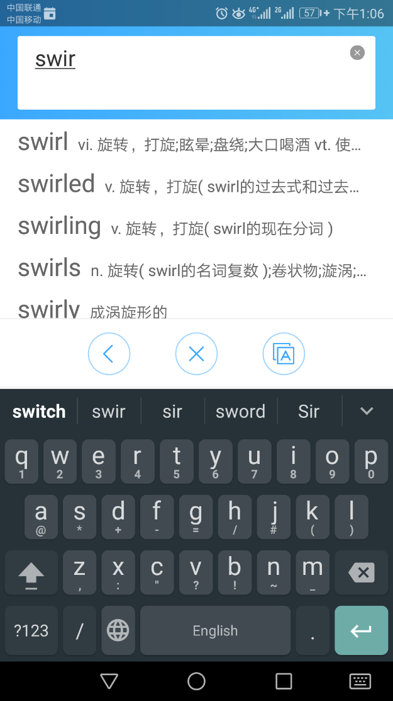
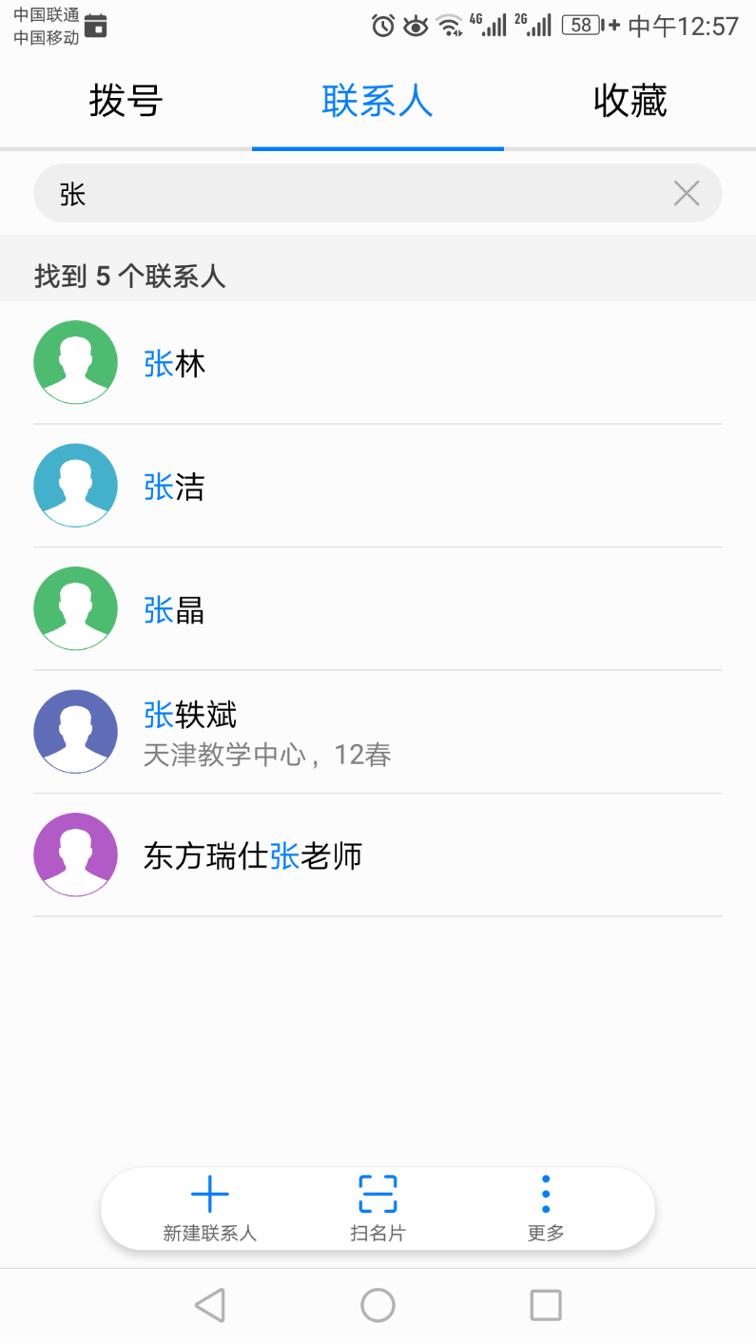
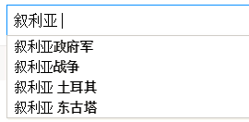
Formulation
When users are unsure of the exact value of the field, variants can be accepted
Case sensitivity, stemmed version, partial match, phonetic variant, synonym, abbreviation, ...
The result list can be displayed as users type.
Auto-completion can speed data entry, help users recall terms of interest, and limits misspelling

Slide 23
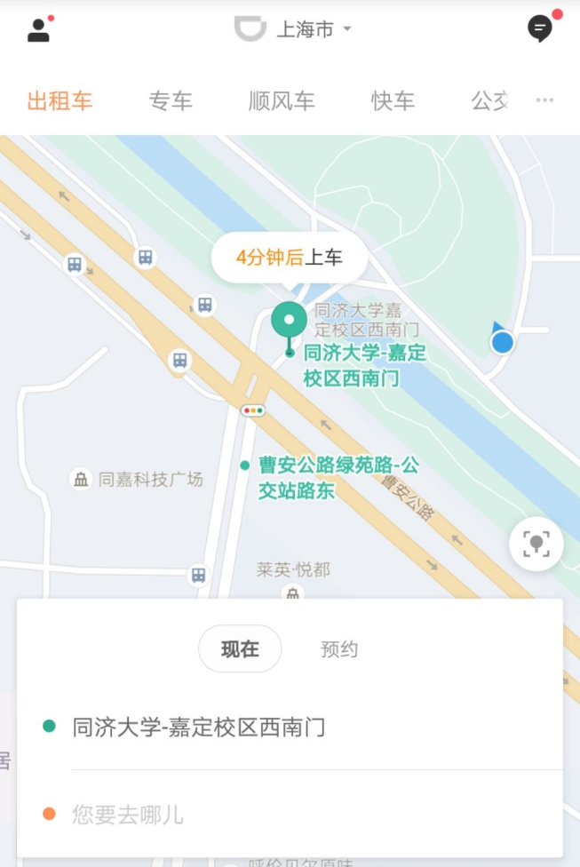
Formulation
Mobile applications may use context information such as location to narrow down the auto-completion

Slide 24

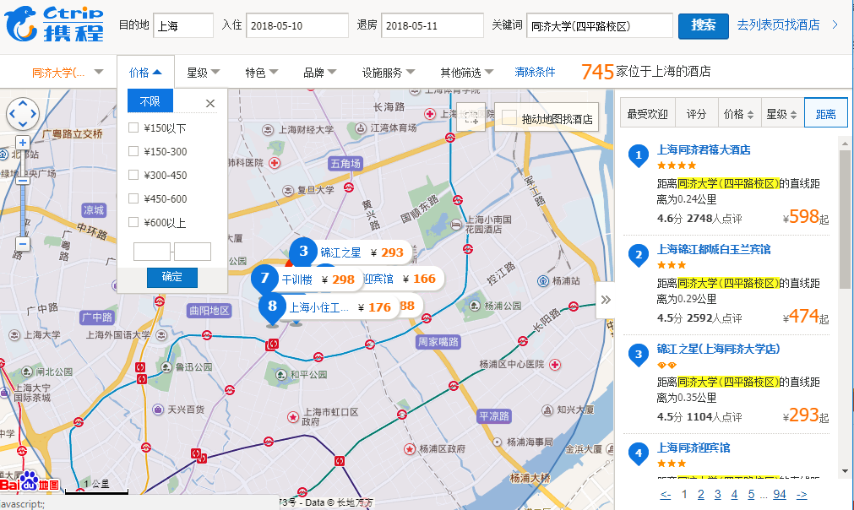
Initiation of action
Explicit search
A search button
A magnifier glass is the standard icon for search
Pressing the Enter key on a keyboard
Pausing during spoken interaction
Implicit search
Dynamic queries

Slide 25
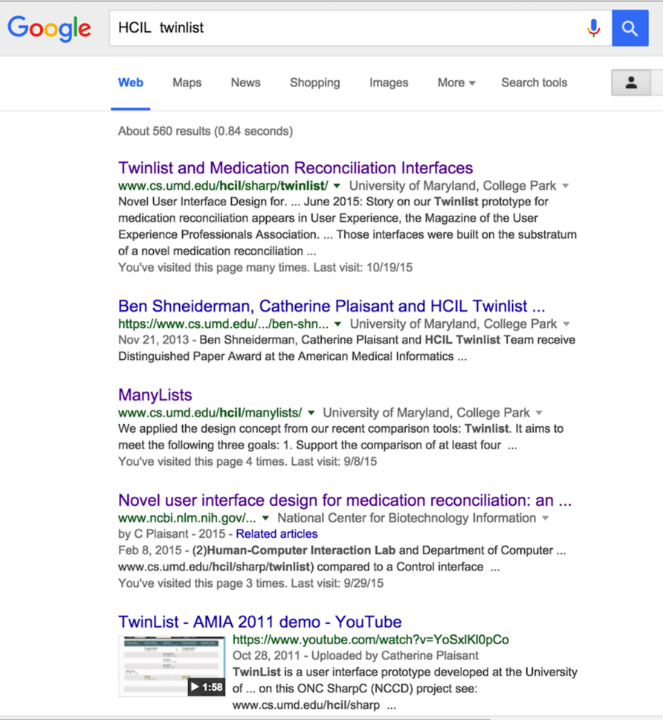
Review of results
Users review results in textual list, on geographical maps, timelines, or other specialized visual overviews of results
A Google Search result list
A summary is provided at the top (the total number of results)
Each result includes preview information (or snippet)
Search terms are highlighted, including “Human-Computer Interaction Lab” which is the expanded variant of the search term HCIL
The name of the top-level organization was added (here “National Center for Biotechnology Information”) to help users judge the trustiness of the information
Notes:
If no items are found, the failure should be indicated clearly
When results are presented in a list, it is common to return only about 20 results, but larger initial sets are preferable for those with high band-width and large displays.

Slide 26
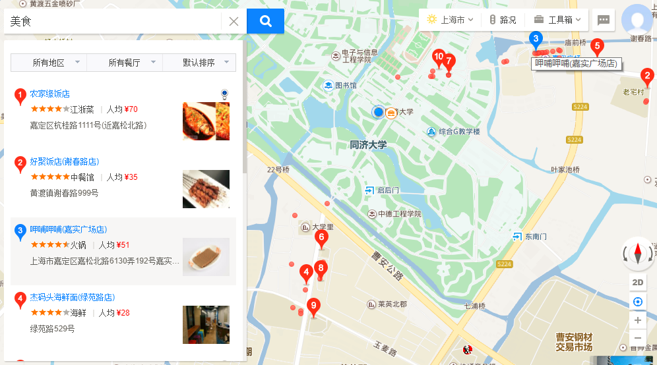
Review of results
Notes:
Searching for Annapolis on the real estate website Zillow returns a list of houses and dots displayed on a map.
The two windows are coordinated; when the cursor hovers over a house in the result list, the location of the house is indicated on the map.
A click on the house would bring all the details displayed in an overlapping window.

Slide 27
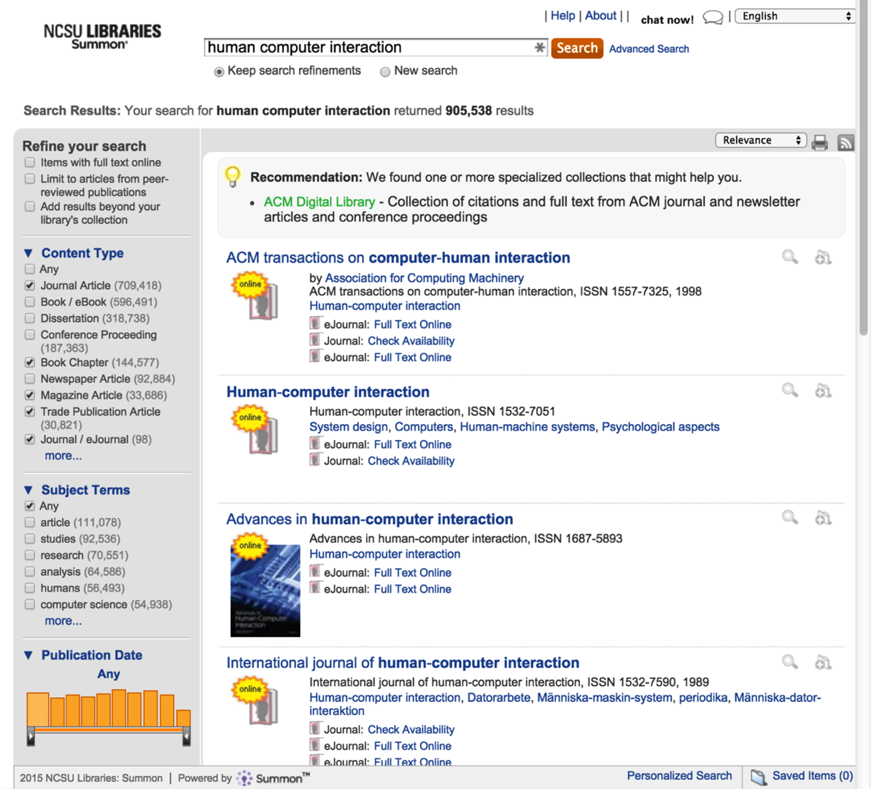
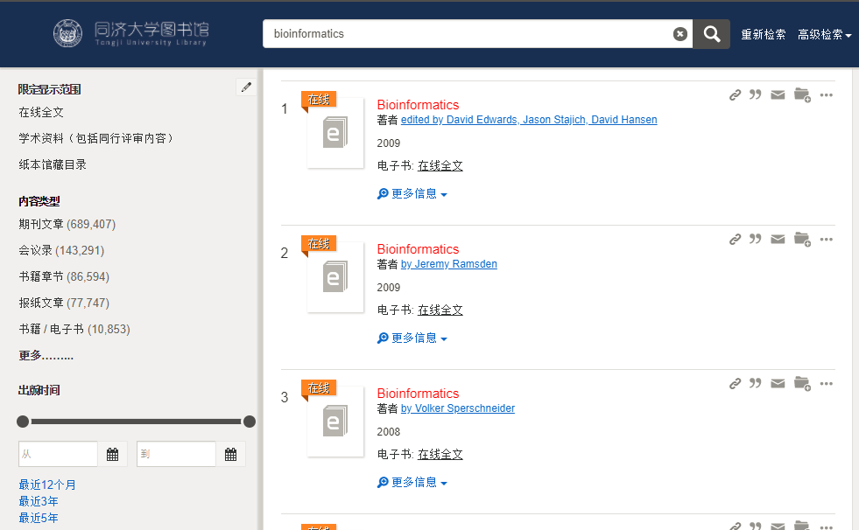
Review of results
Notes:
A search for “user interface” powered by SummonTM for a university library catalog returns a very large number of results
On the left users can see the number of results for categories organized by Content Type, Subject Terms, or Publication dates. It provides an overview of the results, reveals how the search was done (e.g. here the default search does not return dissertations) and facilitates further refinement of the search.
The menu at the upper right allows users to sort results by relevance or by date. Help is available with a “Chat now” button, to chat with a librarian.

Slide 28
Refinement
Search interfaces can provide meaningful messages to explain search outcomes and to support progressive refinement
Ask “Did you mean fibromyalgia?” when a term is misspelled
If multiple phrases were used, items containing all phrases should be shown first and identified, followed by items containing subsets
Users can do progressive refinement by changing the search parameters

Slide 29
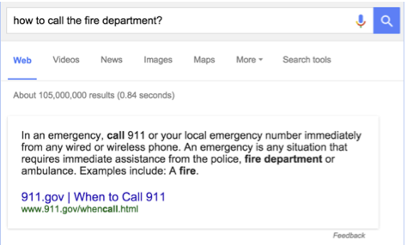
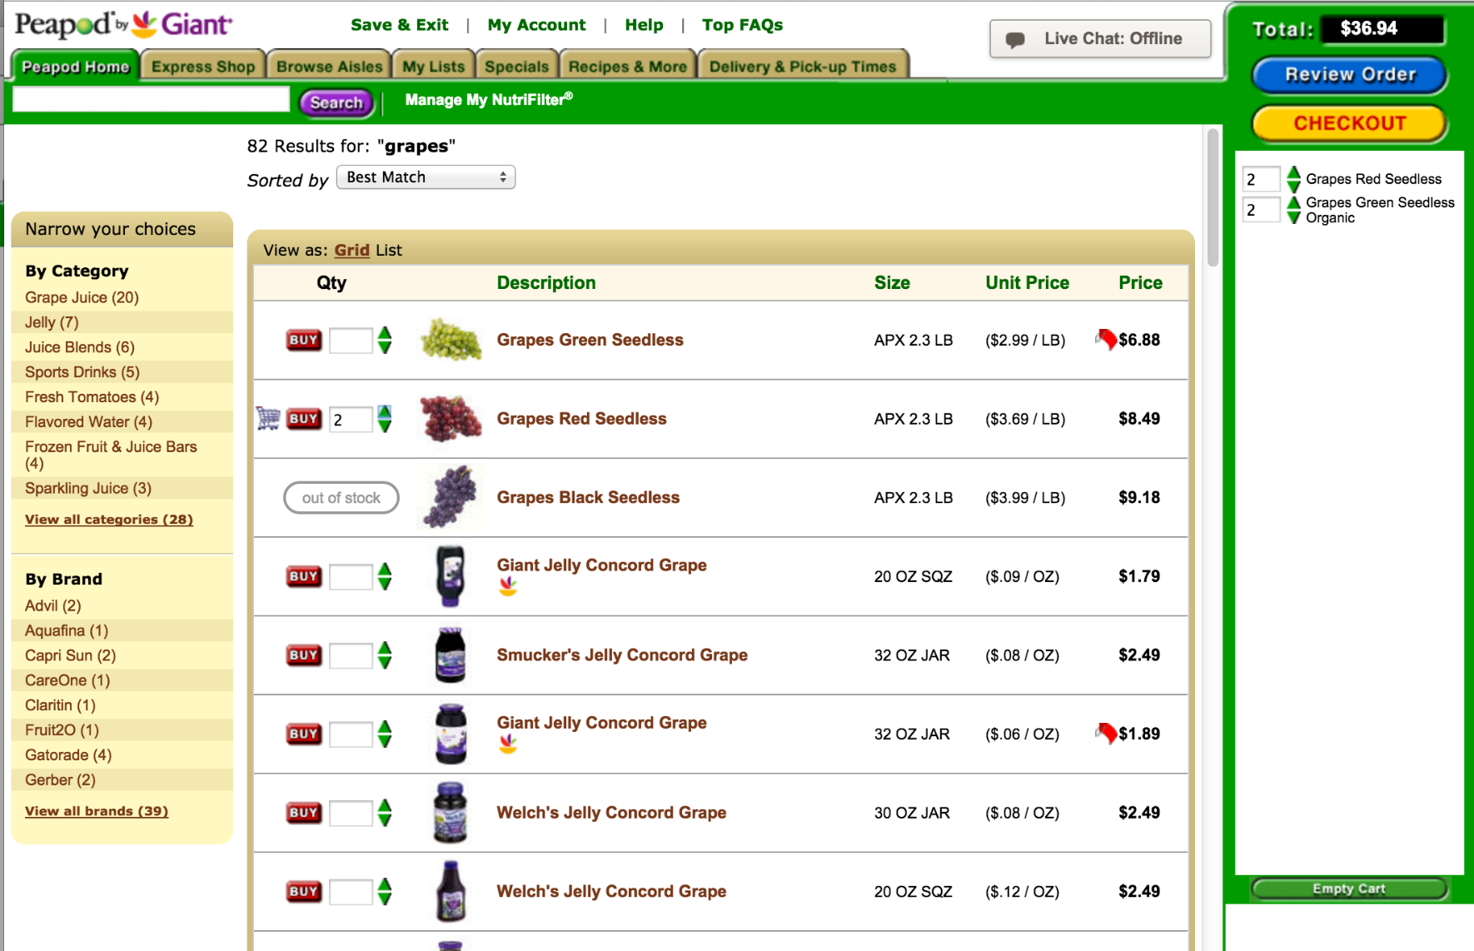
Use
Results may be merged and saved, disseminated by email, or shared in social media
When possible (and important), provide information or simple actions without requiring users to leave the search results page
On the left users get the answer to their safety critical question at the top of the result list
On the right shoppers looking for groceries can specify quantity and buy directly from the list of results after a search on “grapes”

Slide 30
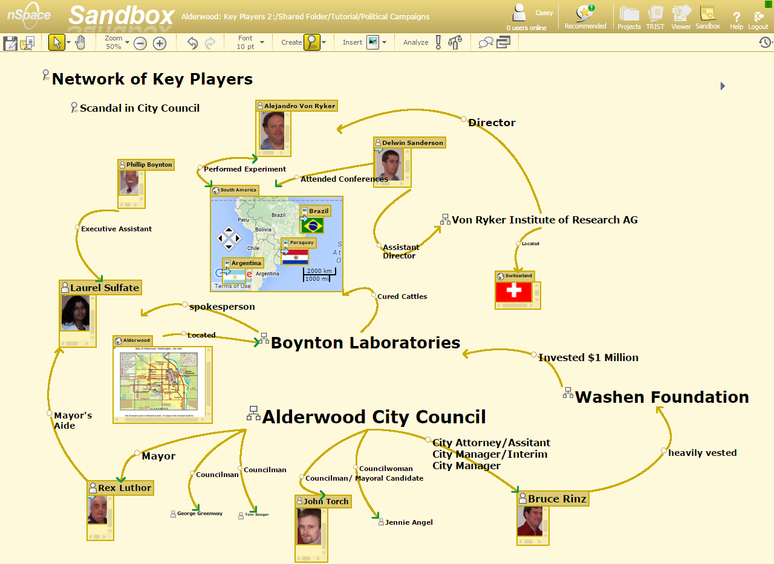
Use
Most often search is only one of many components of a more complex analysis tool
Notes:
nSpace Sandbox®, from Uncharted Software™ allows multiple analysts to organize and present the evidence gathered from research
A variety of tools such as node and link diagramming, automatic source attribution, recursive evidence marshalling, timeline construction, etc. provide support for analysis and reporting

Slide 31
Outline
Introduction
Five-stage search framework
Dynamic queries and faceted search
Command languages and “natural” language queries
Multimedia Document Search & specialized search
The Social aspects of search

Slide 32
Dynamic queries and faceted search
When metadata is available, dynamic query interfaces provide
A visual representation of the possible actions
A visual representation of the objects being queried
Rapid, incremental, and reversible actions and immediate feedback
The dynamic query approach is appealing as it prevents errors and encourages exploration

Slide 33
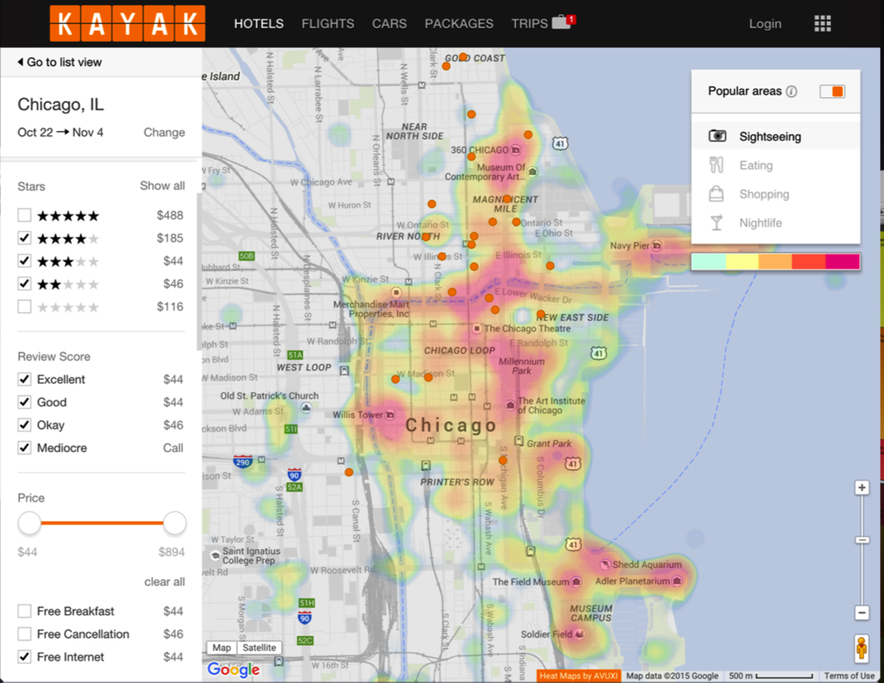
Dynamic queries and faceted search
Visual search interface
The hotel search interface of the Kayak travel website
Notes:
After using a form fill-in to provide the location (Chicago) and dates results are displayed in a traditional list or a map
The map provides an overview of the location of the hotels and can be zoomed to narrow the results. It was also augmented with a visualization of the popular sightseeing areas.
On the left menus are available to narrow down the categorical values, and sliders for numerical values
Price is important so the average price is provided for each category values

Slide 34
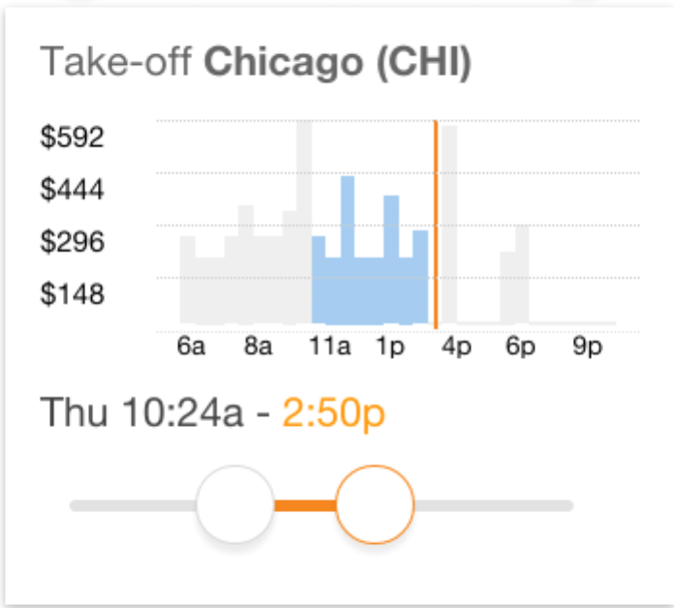
Dynamic queries and faceted search
A preview of the price of available flights guides users narrow down the time range for take-off
The preview eliminates empty result sets, and avoids high expenses

Slide 35
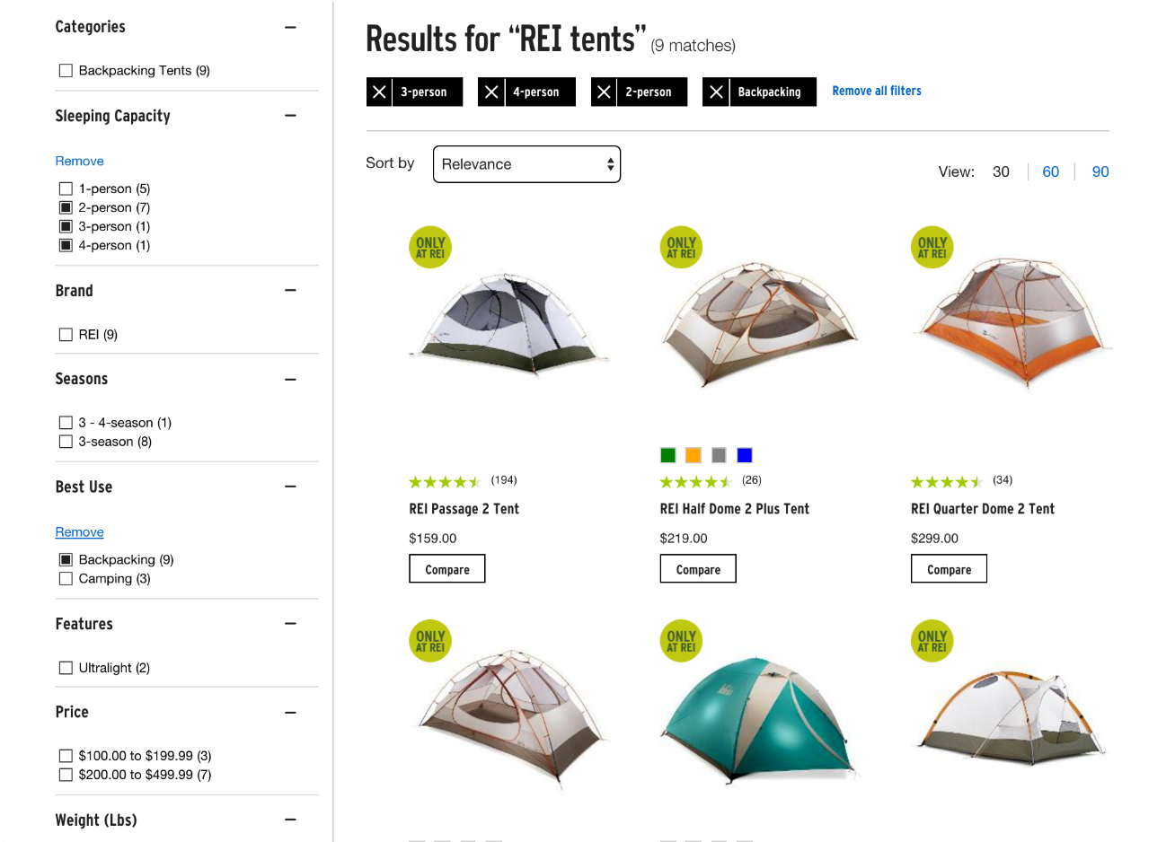
Dynamic queries and faceted search
Faceted search interface of REI
Notes:
Here users searched for “REI tents” and then browsed different tents by selecting values for multiple categories
The selected filters are clearly indicated at the top with black background, making easy for users to review the constraints and remove them

Slide 36
Outline
Introduction
Five-stage search framework
Dynamic queries and faceted search
Command languages and “natural” language queries
Multimedia Document Search & specialized search
The Social aspects of search

Slide 37
Command languages queries
Users may want more control over their queries
Regular expressions allow users to specify patterns of allowed variants
Typing “*terro*” to return documents with “terrorist,” “terrorism,” or “anti-terrorism”
The Structured Query Language (SQL) is a widespread standard for searching relational database systems
SELECT DOCUMENT#
FROM JOURNAL-DB
WHERE (DATE >= 2014 AND DATE <= 2017)
AND (LANGUAGE = ENGLISH OR FRENCH)
AND (PUBLISHER = ASIST OR HFES OR ACM)
Notes:
Form filling, dynamic queries, and faceted search allow users to specify fairly complex queries. A subset of Boolean queries is possible (Ors between attribute values and ANDs between attributes), but some users may want even more control over their queries.

Slide 38
“Natural” language queries
Boolean expressions conflict with English usage
“List all employees who live in New York and Boston”
“I’d like Russian or Italian salad dressing”
Web search with “natural” language queries is appealing
Often the semblance of a natural language query is achieved simply because the answers has been provided by human
“How do I fix a flat?”
“Howe do I connect wii and dvd to my tv?” – video selector or two way A/V switcher

Slide 39
Outline
Introduction
Five-stage search framework
Dynamic queries and faceted search
Command languages and “natural” language queries
Multimedia Document Search & specialized search
The Social aspects of search

Slide 40
Multimedia document search & other specialized searches
Image search
Video search
Audio search
Geographic information search
Multilingual search
Other specializes searches

Slide 41
Multimedia document search
Interfaces for multimedia document search have been gradually improved
Most systems depend on text searches, keywords, tags, and metadata
But many multimedia documents remain untagged
Multimedia-document search interfaces that integrate powerful annotation and indexing tools, search algorithms, and media-specific browsing techniques for viewing the results lead to successful outcomes

Slide 42

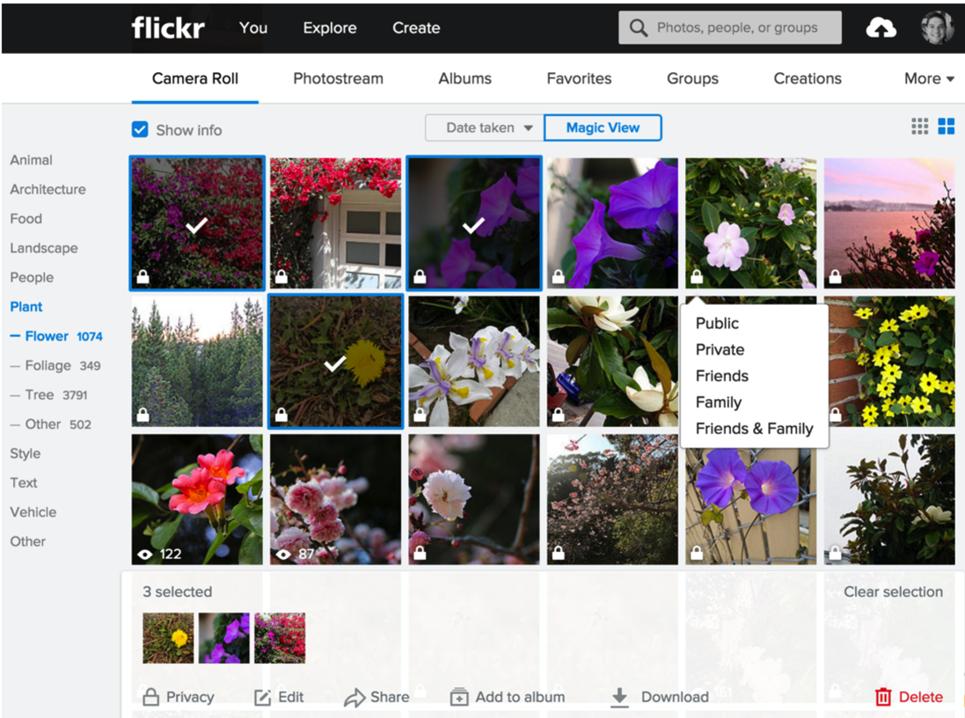
Image search
Image-analysis researchers describe this task as query by image content (QBIC)
Another important applications: Face recognition
Notes:
The “Magic View” of Yahoo photos automatically generates topic tags for each photo
Here users selected the photos with flowers
Three photos are selected and ready to be shared
The privacy setting is visible and can be changed with a menu

Slide 43
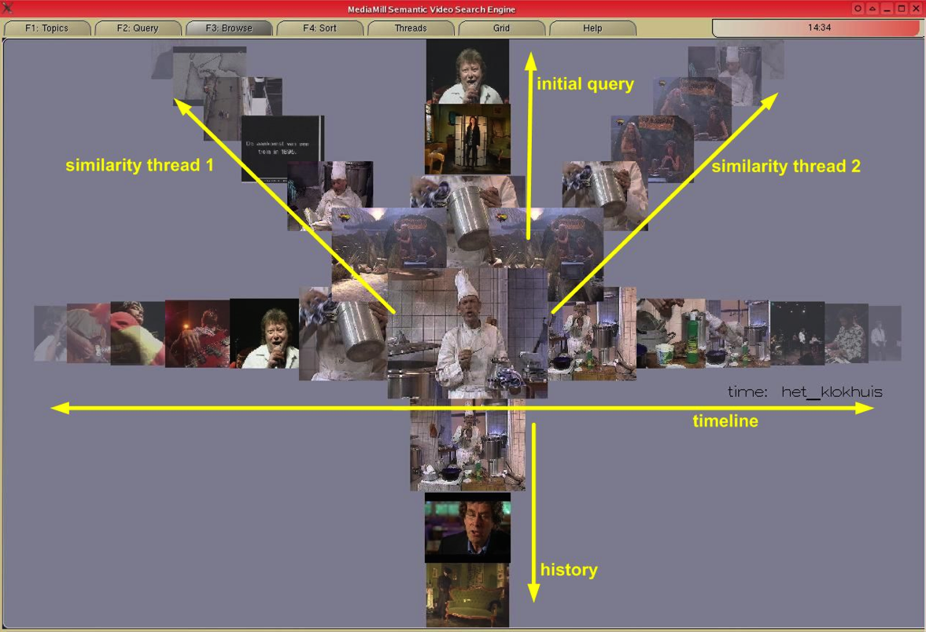
Video search
Identifying videos that include objects, actions, or events of interest and analyzing them remains a challenge
Video analysis include object tracking, text in the scenes, and speech-to-text transcripts
Notes:
The ForkBrowser of the MediaMill semantic video search engine (de Rooij, 2008) which allows the user to browse the video collection along various dimensions exploring different characteristics of the collection

Slide 44

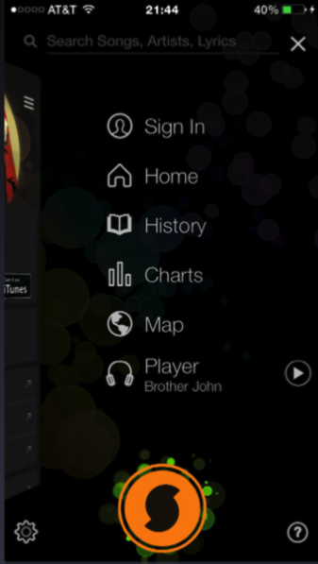
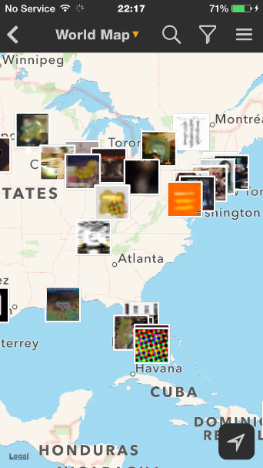
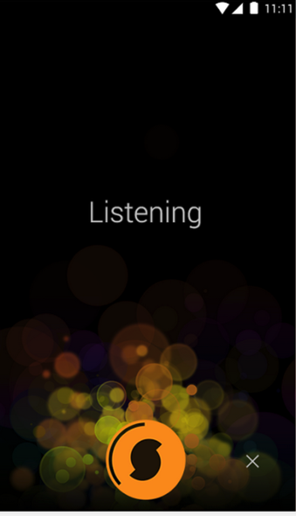
Audio search
Music-information retrieval systems use audio input, where users can query with musical content
Users can sing or play a theme, and the system returns the most similar items

Slide 45
Geographic information search
Geographic information is increasingly used to inform search
Sensors on the ground or onboard vehicles provide the information for queries
“Where is the closest gas station?”
User interfaces providing map displays allow users to geographically consider the results
Challenges need to be addressed
What to show on the map
Design dynamic legends
Improve interaction with maps

Slide 46
Outline
Introduction
Five-stage search framework
Dynamic queries and faceted search
Command languages and “natural” language queries
Multimedia Document Search & specialized search
The Social aspects of search

Slide 47

The social aspects of search
Social search is “an umbrella term” describing search acts that make use of social interactions with others
May be explicit or implicit, co-located or remote, synchronous or asynchronous
Social bookmarking and ranking, e.g. Reddit
Personalized search built on user profiles, e.g. past site visits
Collaborative filtering and recommender systems, e.g Netflix
Music recommendation, e.g. Pandora
Human-powered question answering

Slide 48
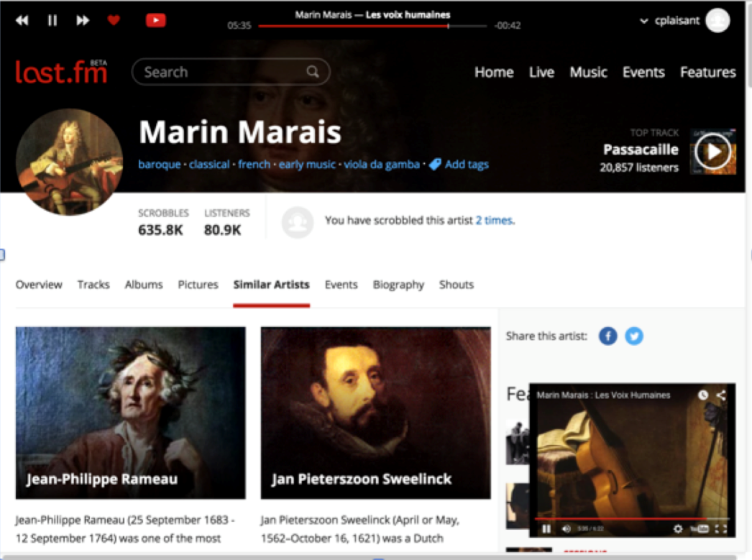
The social aspects of search
Last.fm is an example of online radio using playlists created automatically
The process starts by users selecting a start point (e.g. a song or artist they like) then users provide feedback on the suggestions by clicking on the heart or skipping the track

